Slide 1

Computer Peripheral and Interfacing
Lecture – 1

Slide 2
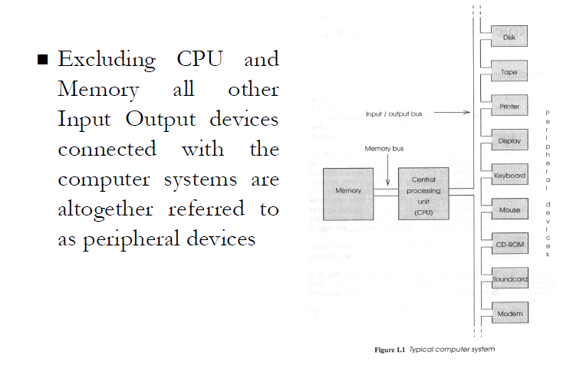
A peripheral is a piece of computer hardware that is added to a computer in order to expand its abilities.

Slide 3

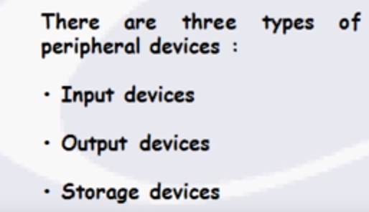

Slide 4

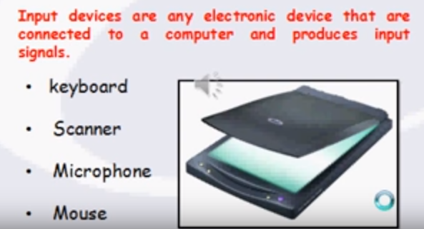

Slide 5

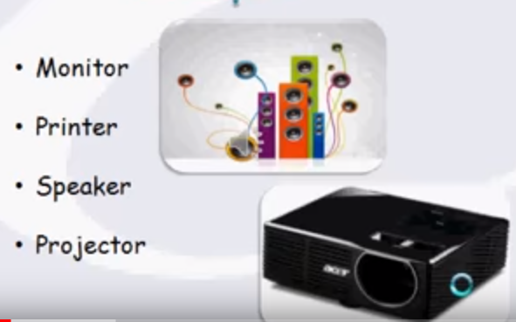

Slide 6

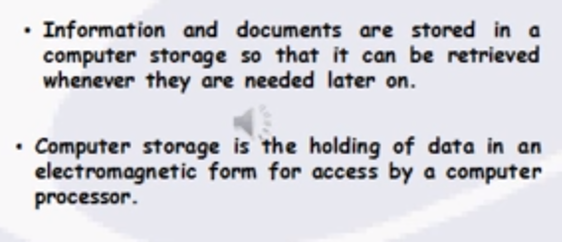
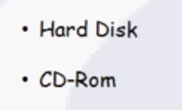

Slide 7

The functional units of the computer must be organized so that all its units can handle one full word of data in a given time.
When a word of data is transferred between two units, all the bits are transferred simultaneously at the same time, over many wires/lines, one bit/wire.
Such a group of lines serving as a connecting path is called a bus.
Faruk Hossen, Asst. Prof., GSTU

Slide 8
Bus not only carries data, but also addresses and control signals.
The simplest way to inter connect functional units(includes I/O devices) is to use a single bus.
But then , that bus can be used for only one transfer at a time actively between two units.
So, only two units can access that bus at a single time.
Faruk Hossen, Asst. Prof., GSTU

Slide 9
  Since in a single bus structure, all the devices have to communicate over that single bus, an efficient way is required to make these slow I/O devices compatible with faster units.
  A common approach to smooth out this differences in speed is to use another special storage, called buffer register.
  The task of the buffer register(with each I/O device) is to hold data during transfer.
Faruk Hossen, Asst. Prof., GSTU

Slide 10
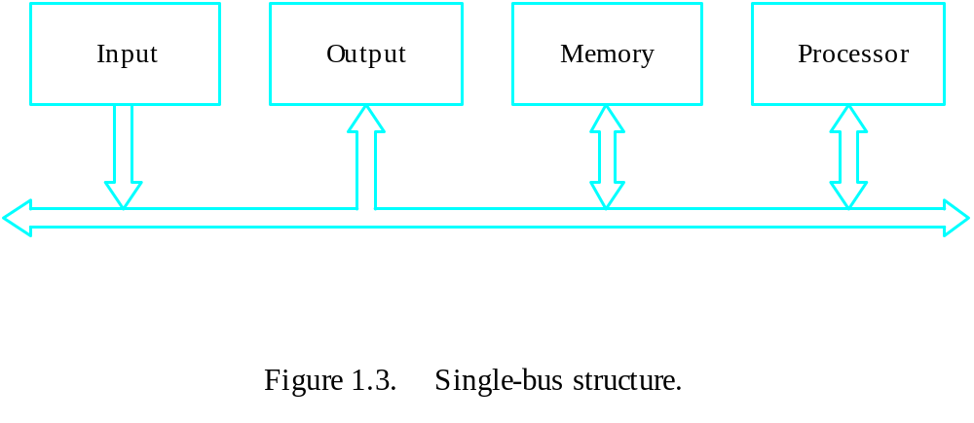
Faruk Hossen, Asst. Prof., GSTU

Slide 11
Example of using a buffer register :
  Assume, we have to print a character.
  The processor sends the encoded character over the bus to the printer buffer register.
  Since, register can operate in electronic speed, this transfer takes less time, because according to speed, buffer register is compatible with the processor.
Faruk Hossen, Asst. Prof., GSTU

Slide 12
  After the buffer is loaded, printer cam slowly print it, then there no problem is created due to the slow printer.
  And the processor also need not wait for the printer to finish its job.
  After giving the character the to buffer register, it can go back to its next task.
  So, here the buffer register with the printer is used to smooth out the speed difference.
Faruk Hossen, Asst. Prof., GSTU

Slide 13

Since, in this single bus structure, three types of information(data, address and control signal) is passed through this single bus,
  It consists of three sets of wires to carry data, address and control signal.
  Each I/O device has a unique address.
  To access a particular I/O device, the processor places the address of that device on the address line.
Faruk Hossen, Asst. Prof., GSTU

Slide 14
  The device corresponding to the device recognizes its address.
  Responds to the command issued in the control signal on the control information lines.
  The processor requests either read or write operation.
  The requested data is then transferred over the data lines.
Faruk Hossen, Asst. Prof., GSTU

Slide 15
Processor
Memory
Bus
I/O de
vice 1
I/O de
vice
n
Figure 4.1. A single-bus structure.
Faruk Hossen, Asst. Prof., GSTU

Slide 16
Memory-mapped I/O :
  If memory and I/O devices share the same address space , the arrangement is called memory-mapped I/O.
  DATAIN is the address of the input buffer and DATAOUT is the address of the output buffer of an I/O device.
  For example, if Move DATAIN, R0 is an instruction, then it transfers the content of the
Faruk Hossen, Asst. Prof., GSTU

Slide 17
  memory address DATAIN associated with the input buffer of some input device(say, keyboard) into Ro register.
  Similarly, Move Ro, DATAOUT instruction moves the content of Ro register into the memory location DATAOUT, associated with the output buffer of some output device(say monitor).
  Most of the computer system use memory-mapped I/O because it leads to a simpler s/w.
Faruk Hossen, Asst. Prof., GSTU

Slide 18
  When a special control signal for I/O access is asserted, I/O devices examine the lower order bits of the address bus.
  H/W requirements to connect an I/O device with the bus :
  Address Decoder :
    Enables the I/O device to recognize its corresponding address when its address appears in the address lines.
    Connected to the address lines of the bus.
Faruk Hossen, Asst. Prof., GSTU

Slide 19
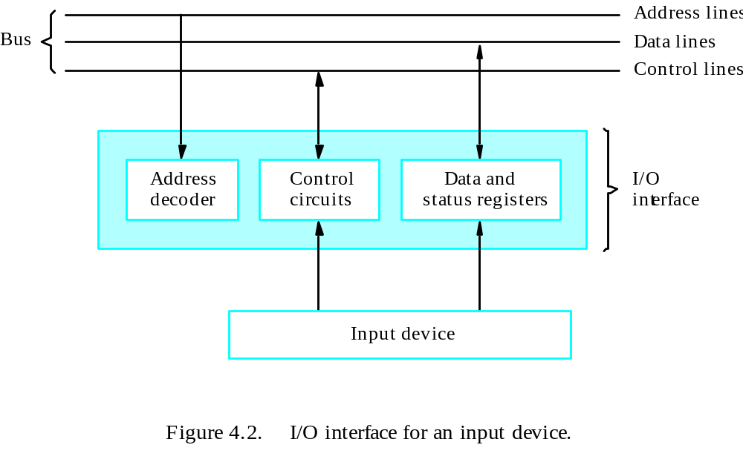
Faruk Hossen, Asst. Prof., GSTU

Slide 20
  Data and Status Register :
    The data register holds the data being transferred to or from the processor.
    The status register contains information relevant to the operation of I/O devices.
    Both the data and status registers are connected to the data bus and the I/O device.
    Each of these registers are assigned a unique address.
  Control Circuits :
    Coordinates the total I/O transfer operation.
Faruk Hossen, Asst. Prof., GSTU

Slide 21
  This address decoder, data register, status register and the control circuitry constitutes the I/O device’s interface circuit.
  Some other basic idea’s for performing I/O operation :
    SIN Flag : Status flag, part of the status register. This flag is set to 1, when there is some data in the input buffer of an input device, otherwise cleared to 0.
    SOUT Flag :Status flag, part of the status register. This flag is set to 1, when there is some data in the output buffer of an output device, otherwise cleared to 0.
Faruk Hossen, Asst. Prof., GSTU

Slide 22
Example : Write a program that takes a line of characters one by one as input and show them in any output device.
Solution :
  The 4 registers, DATAIN, DATAOUT, STATUS, CONTROL are involved in any I/O operation.
  Only two flags, SIN and SOUT is necessary in this example.
Faruk Hossen, Asst. Prof., GSTU

Slide 23
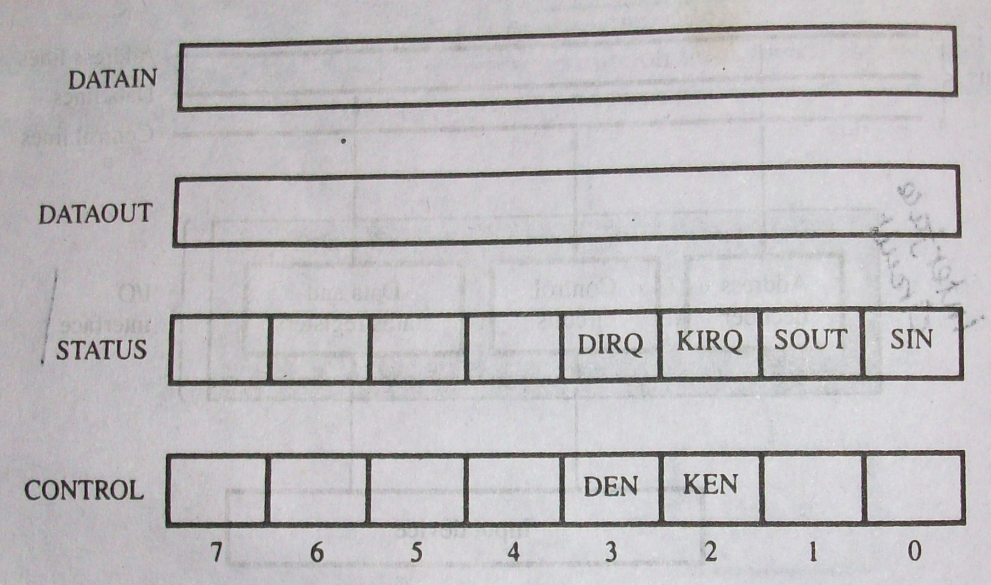
Faruk Hossen, Asst. Prof., GSTU

Slide 24
  Others bits in the STATUS and CONTROL registers(DIRQ, KIRQ, DEN, KEN) are not needed to be discussed for this problem.
  Data from the input device(say, keyboard) are available in the DATAIN register, and
  Data that is to be shown in a output device(say, monitor) is sent the DATAOUT register.
Faruk Hossen, Asst. Prof., GSTU

Slide 25
 | Move | #LINE, R0 | Initialize memory pointer
WAITK | TestBit | #0, STATUS | Test SIN(0th bit of STATUS register)
 | Branch = 0 | WAITK | Wait for character to be entered
 | Move | DATAIN, R1 | Read character
WAITD | TestBit | #1, STATUS | Test SOUT(1st bit of STATUS register)
 | Branch = 0 | WAITD | Wait for display to become ready
 | Move | R1, DATAOUT | Send character to display
 | Compare | #$0D, R1 | Check if carriage return
 | Branch ≠ 0 | WAITK | If not, get another character
 | Move | #$0A, DATAOUT | Otherwise, send Line Feed
 | Call | PROCESS | Calls a subroutine to process the input line
Faruk Hossen, Asst. Prof., GSTU

Slide 26
  In the above program, R0 acts as a pointer to the character to be taken as input from keyboard.
  The memory location of the start of the line of character is #LINE.
  Now, in the following program, we make a slight change, that is, read the line of character from keyboard, store it in a memory location(buffer) and then display it into monitor
  A single line is to be added to store the character in the R1 into the memory location pointed by R0.
Faruk Hossen, Asst. Prof., GSTU

Slide 27
 | Move | #LINE, R0 | Initialize memory pointer
WAITK | TestBit | #0, STATUS | Test SIN(0th bit of STATUS register)
 | Branch = 0 | WAITK | Wait for character to be entered
 | Move | DATAIN, R1 | Read character
WAITD | TestBit | #1, STATUS | Test SOUT(1st bit of STATUS register)
 | Branch = 0 | WAITD | Wait for display to become ready
 | Move | R1, DATAOUT | Send character to display
 | Move | R1, (R0)+ | Store character and advance the pointer
 | Compare | #$0D, R1 | Check if carriage return
 | Branch ≠ 0 | WAITK | If not, get another character
 | Move | #$0A, DATAOUT | Otherwise, send Line Feed
 | Call | PROCESS | Calls a subroutine to process the input line
Faruk Hossen, Asst. Prof., GSTU

Slide 28
  The above I/O operation is called program-controlled I/O.
    Where the processor repeatedly checks the status flag to maintain the synchronization between processor and I/O device.
    So, here the processor polls the device.
    There are other two mechanism for implementing I/O operation(Interrupts and Direct Memory Access) which will be discussed later.
Faruk Hossen, Asst. Prof., GSTU

Slide 29

Zaky(Chapter 1 : 1.4)
Zaky(Chapter 4 : 4.1)
Class Lecture
Faruk Hossen, Asst. Prof., GSTU

